Slide 1
Predicting Risk to Human Life due to Landslides
ASHLEY KLEEN
LOYOLA UNIVERSITY, MARYLAND
MAY 2025

Slide 2
Introduction
Research Questions
Can reported data on landslides can be used to accurately predict risk to human life?
Is there a place/type of place that is inherently more dangerous?
Which model is most accurate: Random Forest, classification and regression trees (CART), Support Vector Classification (SVC), or SVCLinear?

Slide 3
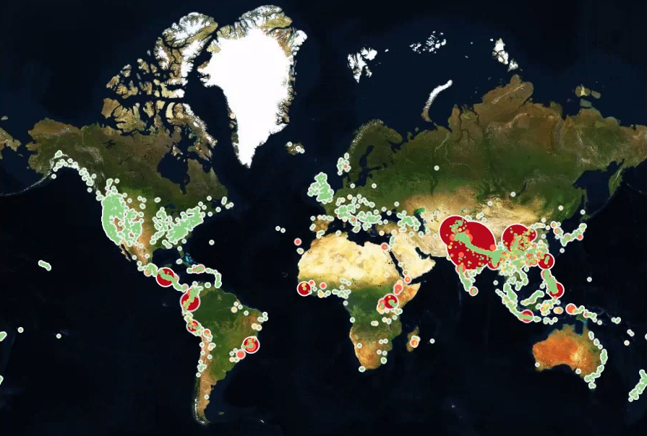
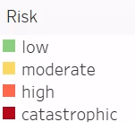
Map of Reported Landslides

Slide 4
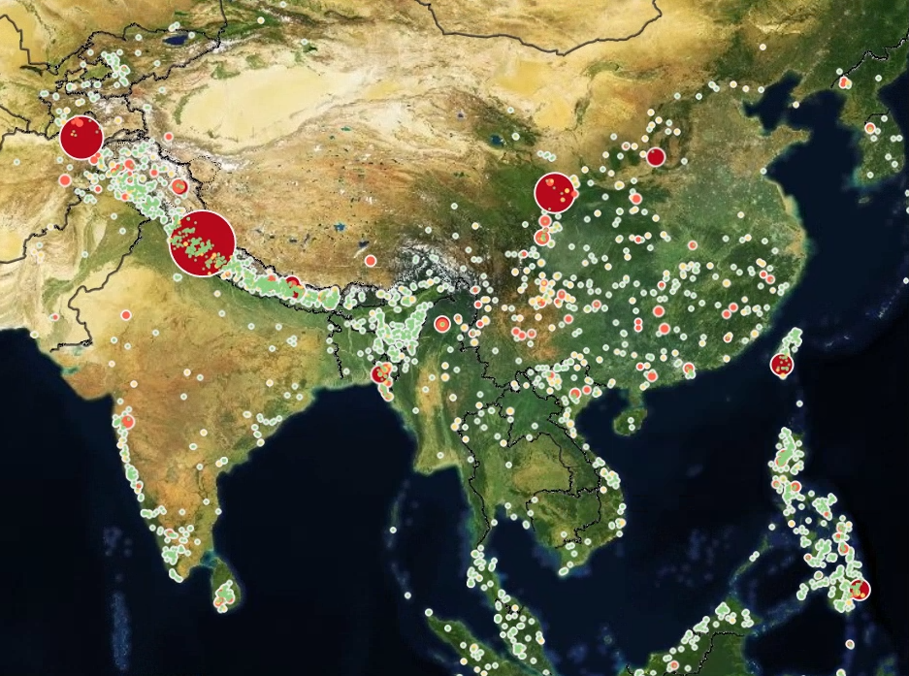
Detailed Map of India and China

Slide 5
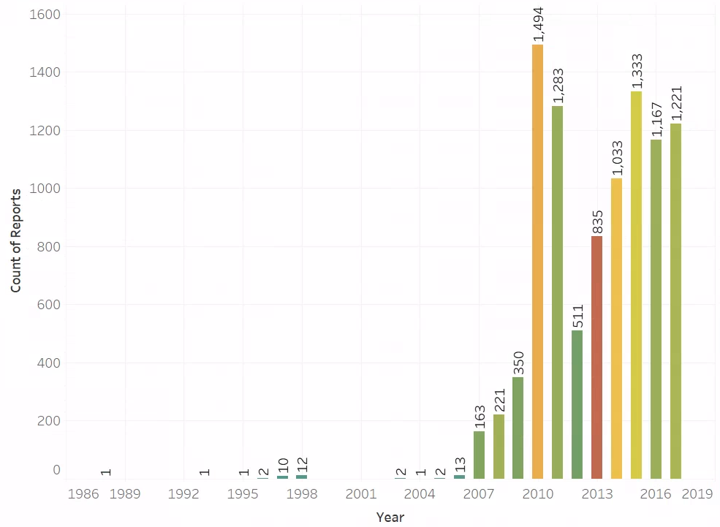

Reports by Year and Colored by Injury/Fatality Count

Slide 6
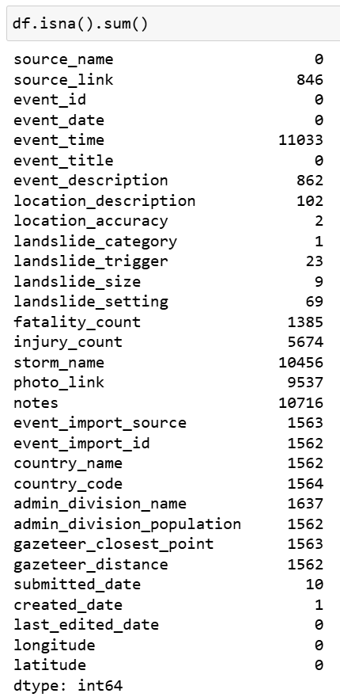
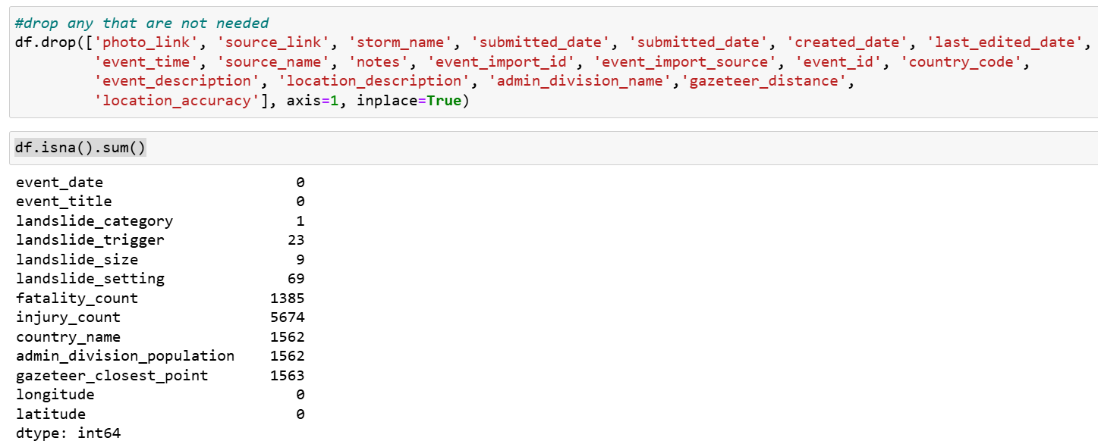
Data Pre-Processing
Original shape: (11033, 31)

Slide 7
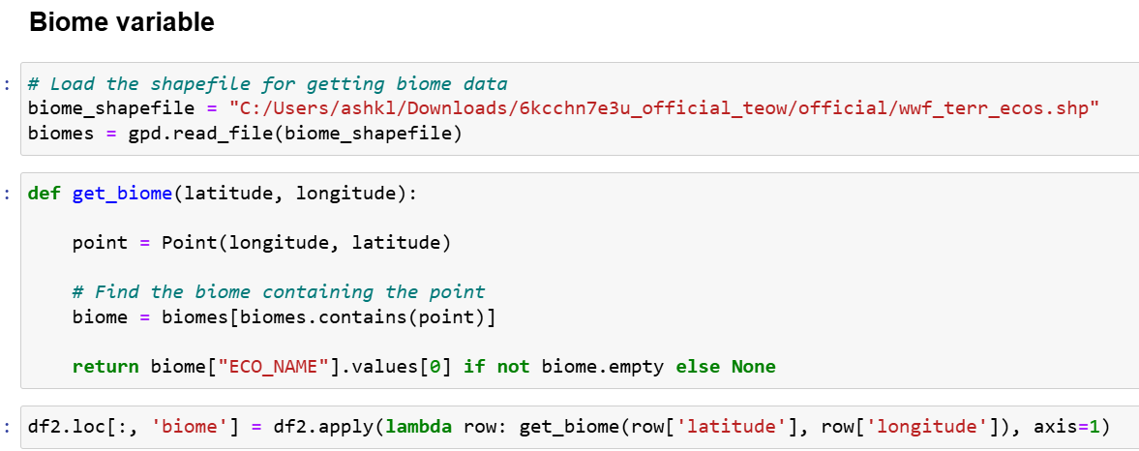
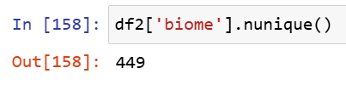
Data Pre-processing
New variables: Month, Year, Season, Biome, Risk

Slide 8
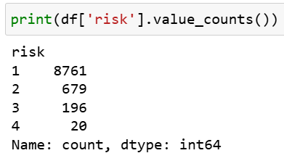
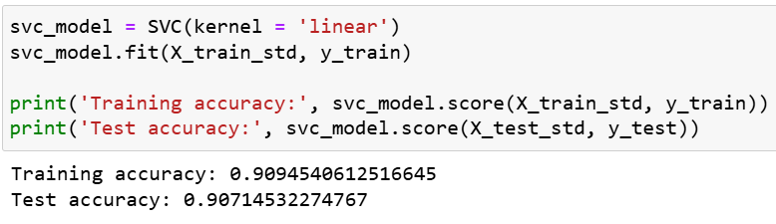
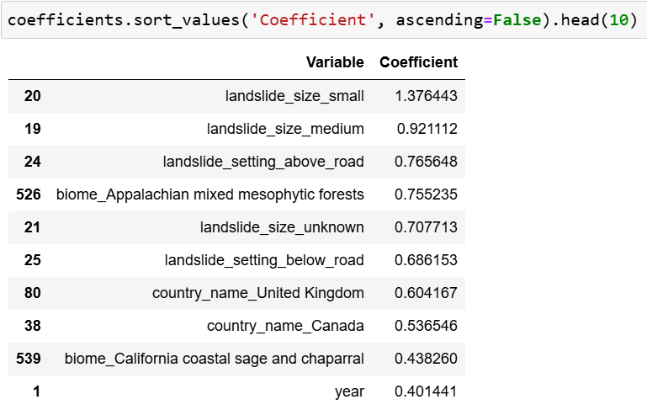
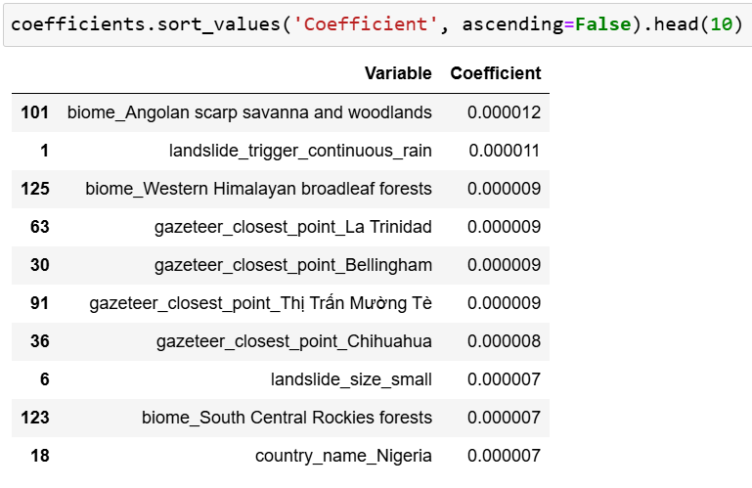
Feature Selection and Challenges
SelectKBest & Corr > 0.80
Filtering features to > 20 SelectKBest scores

Slide 9
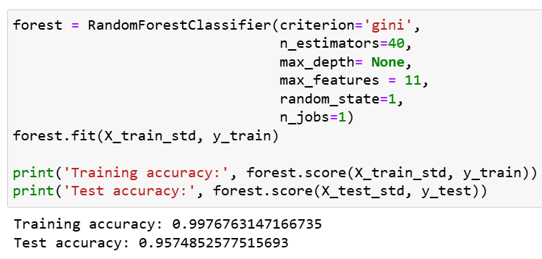
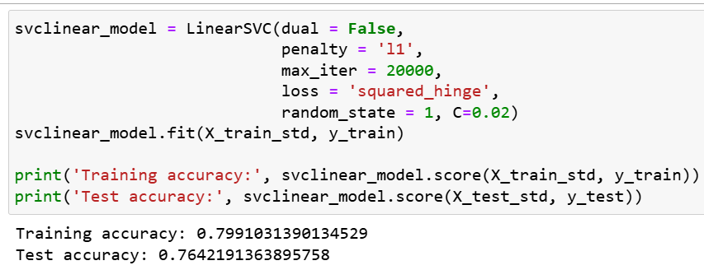
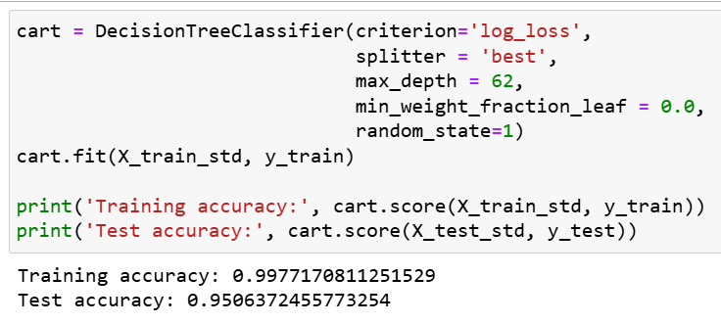
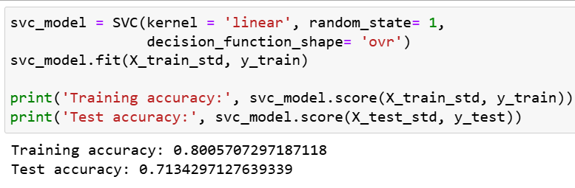
Model Selection

Slide 10
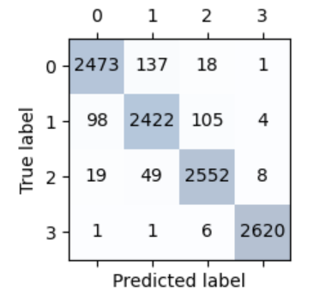
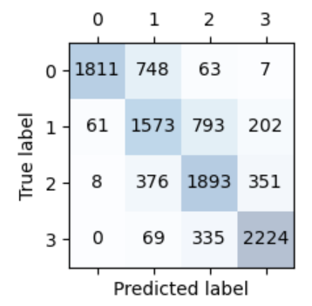


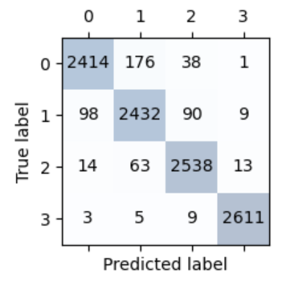
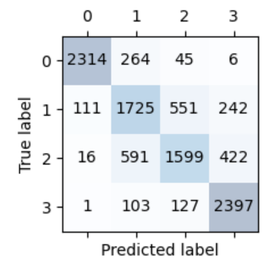


Validation
Random Forest
SVC
CART
SVCLinear

Slide 11
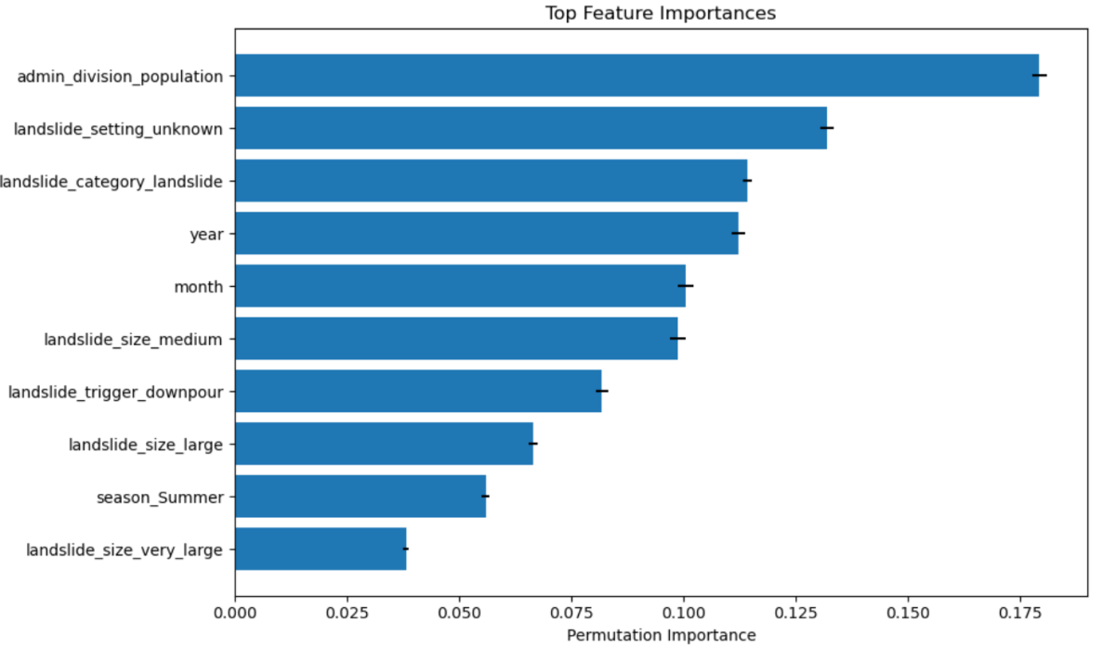
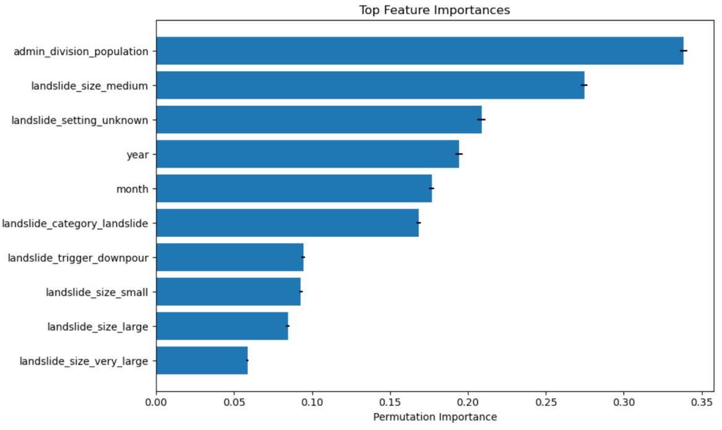
Random Forest and CART Feature Importance
Random Forest
Permutation importance – does not describe the predictive power of the feature, but the importance the feature had on the model
CART

Slide 12
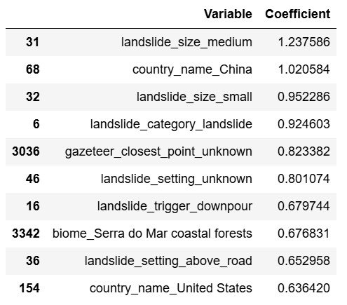
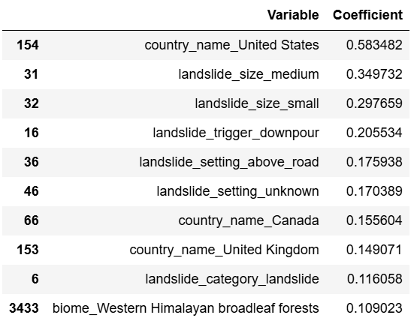
SVC and SVCLinear Feature Importance
SVC
SVCLinear

Slide 13
Conclusions
Random Forest Model is best with 95.7% recall
Local population, landslide size, category, and trigger are all contributors
There is no one particular place that is inherently more dangerous, but the maps consistently show a higher number of reports from mountainous areas
! The model can be used directly after an event to predict need for hospitals or search and rescue events, but cannot be used to be pro-active because it can’t tell you where a landslide may take place or its size
Reported data can be used to create accurate predictions, but cautions and assumptions must be made for missing data or inaccurate data

Slide 14
Questions?

Slide 15
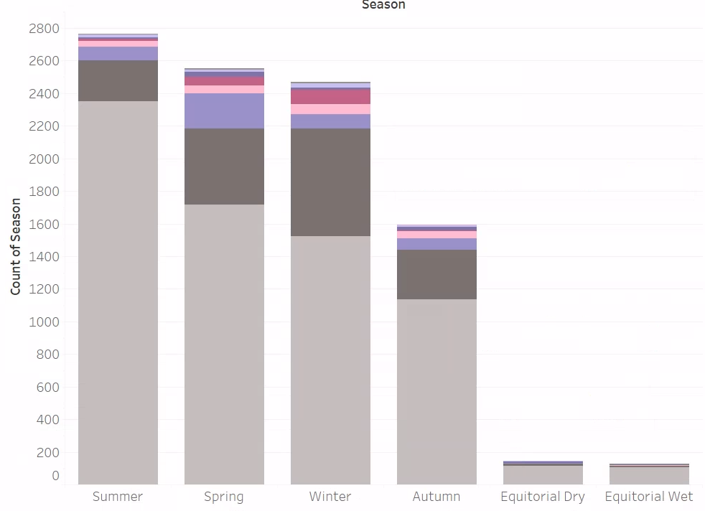
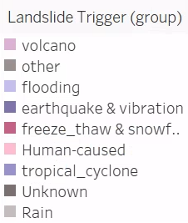
Seasons and Causes

Slide 16
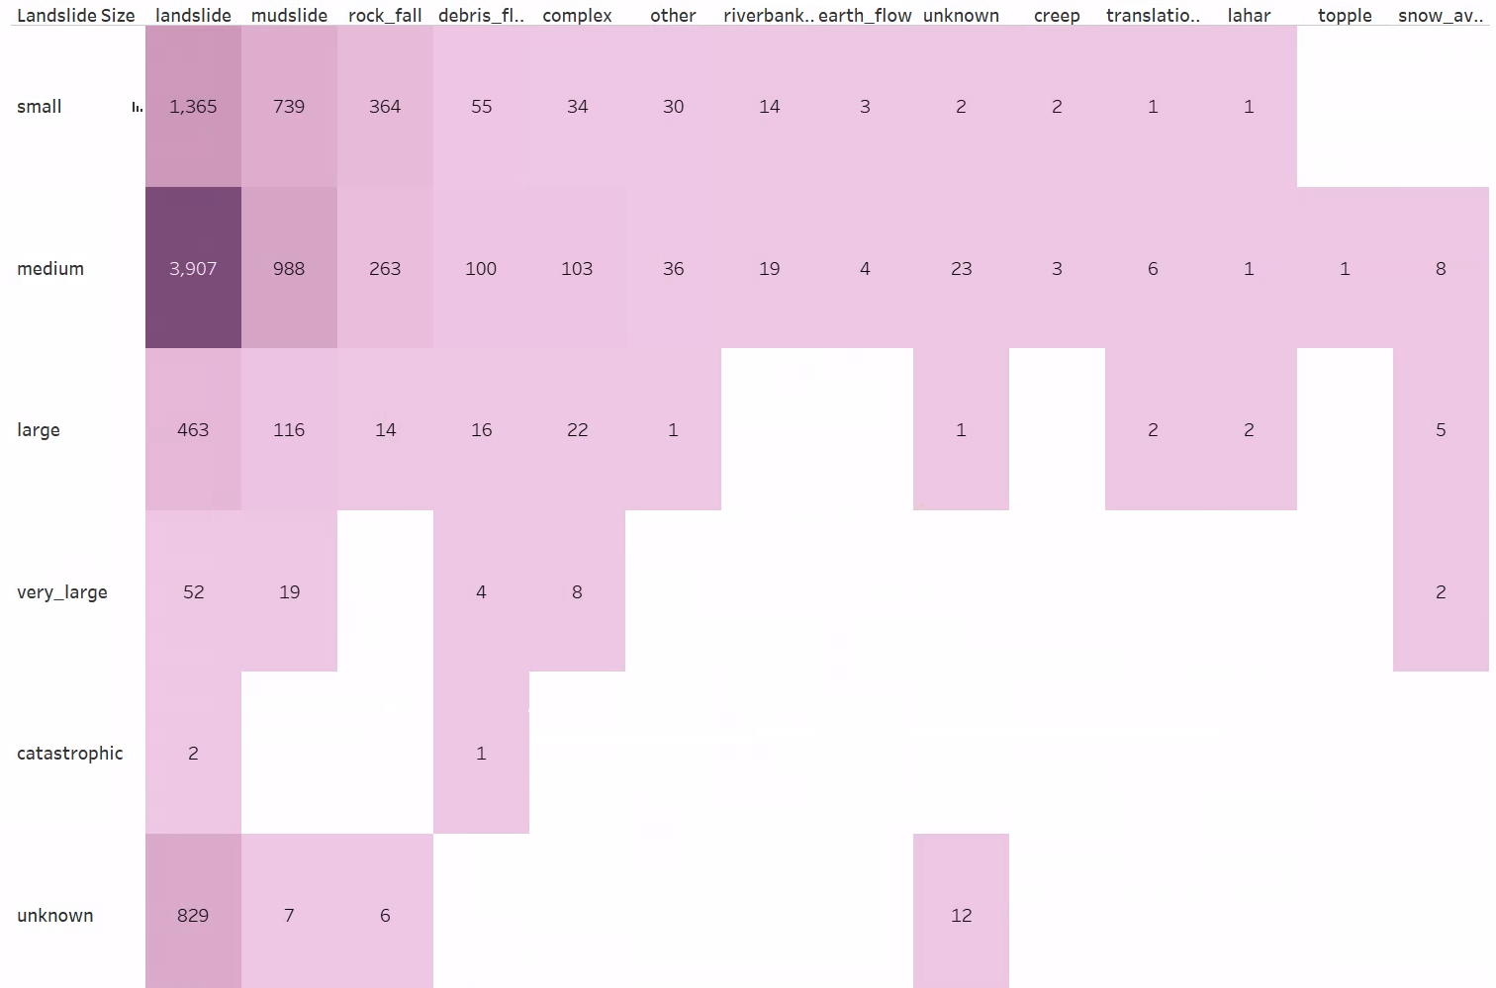
Landslide Sizes and Categories

